Slide 1
Aromy Software
Iteration 2 Presentation
Daniel, Eugene, Allen, Frank, Cassandra (Team OneTen)

Slide 2
Overview
Iteration 1 Retrospective
Iteration 2 Overview
New functionalities
Build on current system
User Personas
Customer
Admin
Project Timeline
Summary
Notes:
D

Slide 3
Iteration 1
The Aim:
Product Management System
Order Management System
Customer Management System
Demo
Feedback
Notes:
The plan ->
What happened
What went well?
What went wrong?
I will now pass to Allen to present our iteration 1 demo.

Slide 4
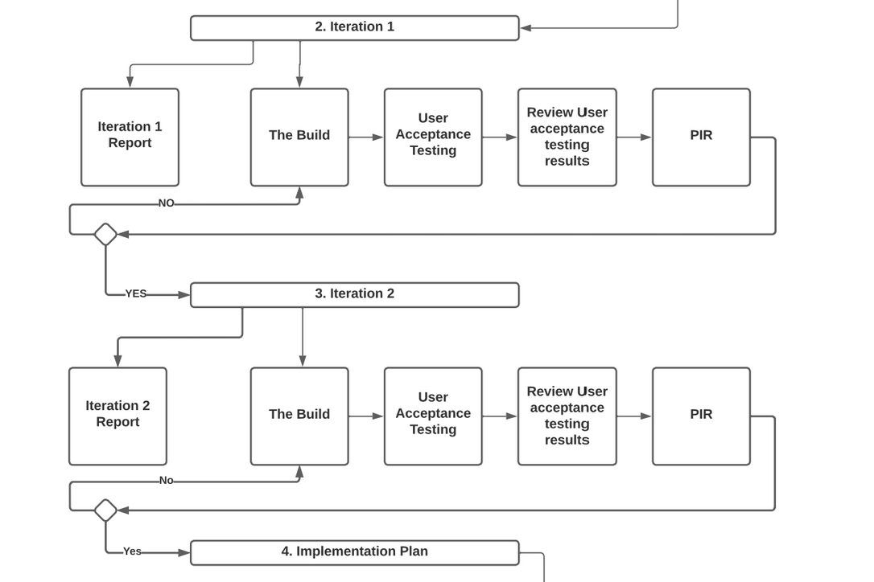
Progress Diagram
Notes:
Dan

Slide 5
Iteration 2 Business Requirements
Customer User Interface
1.1. View Products (Shopping Site)
1.1.1. Create Orders
1.1.2. Manual Order Payment
1.2. Customer Account
1.2.1. Login/Logout
Admin User Interface
2.1 Automated deduction to the SOH when an order is made
2.1.1 Re-order low stock products (add on update SOH)
2.2 Build on the orders page
2.2.1 Send email (confirmation order after the order is paid by the customer)
Notes:
Cassandra

Slide 6
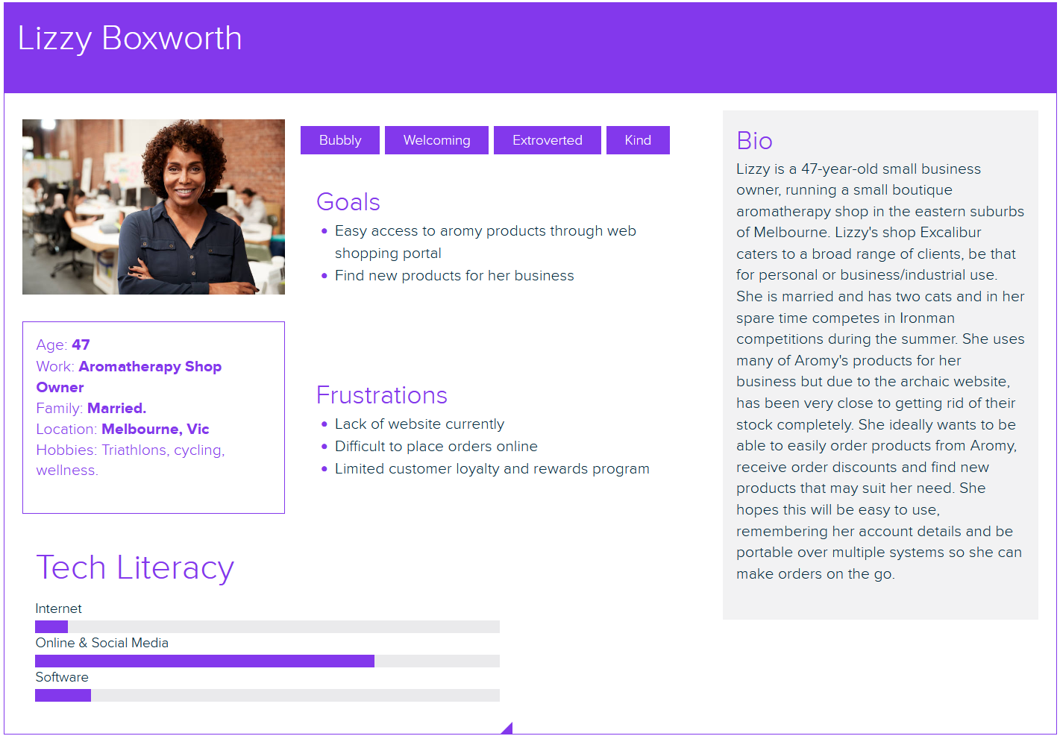
User Personas
Customer:
Notes:
How will these users benefit from the system?

Slide 7
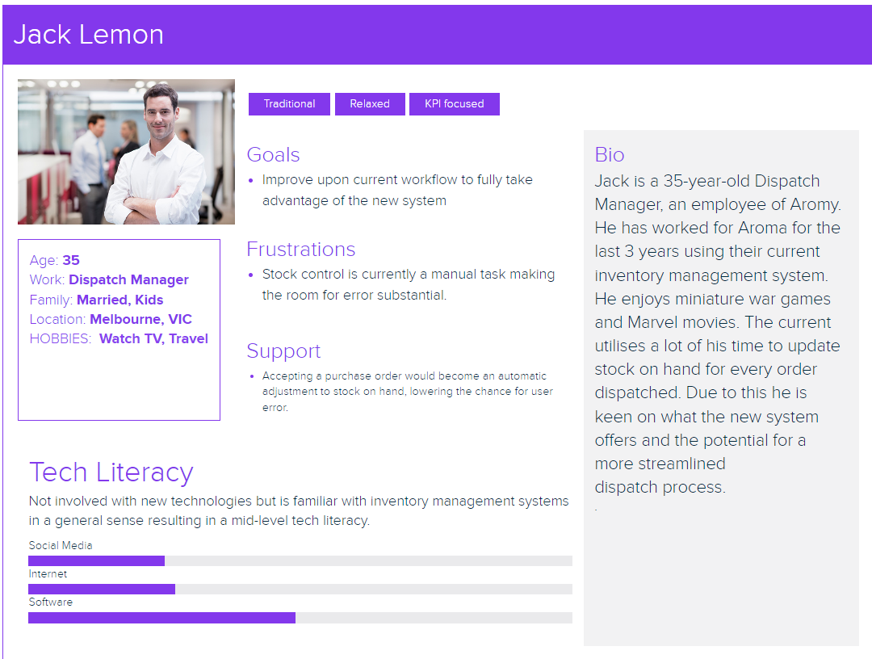
User Personas cont.
Aromy

Slide 8
Project Timeline
FORMAL MEETINGS | DATE | ATTENDEES
Iteration 2 Presentation | 11th September 2022 | Livia (Product Owner) & Team OneTen (All members)
Iteration handover for acceptance and integrity testing | 3rd October 2022 | Livia (Product Owner) & Team OneTen (All members)
Retrospective Artifacts Submitted | 10th October 2022 | Livia (Product Owner) & Team OneTen (All members)
Post-Implementation Review | 10th October 2022 | Livia (Product Owner) & Team OneTen (All members)
Notes:
Frank

Slide 9
Summary
Feedback
Thank you!
Notes:
Cassandra

